Slide 1
Is GDP Affected By Temperature & Precipitation
Group 9
Team Members:
Emeka Obianyor
Kiran Mundae
Charles Robinson
Nick Orewiler
Sadie Barnett-Boudreau

Slide 2






Group 9 Team Members
Sadie Barnett-Boudreau
Charles Robinson
Kiran Mundae
Emeka Obianyor
Nick Orewiler

Slide 3
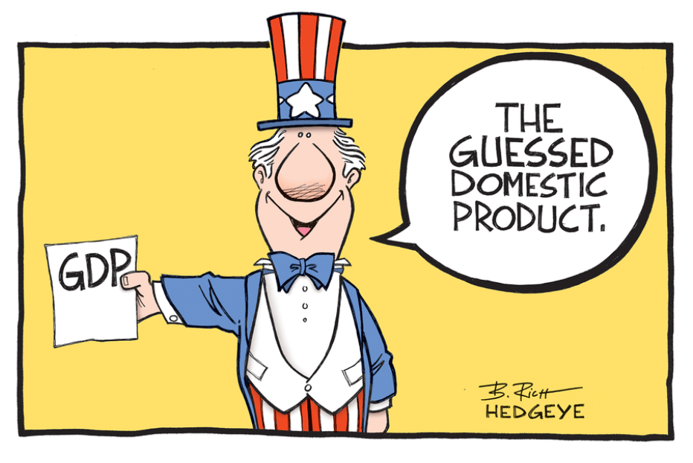
Agenda
Project Description
Overview of Analysis Questions
Dataset Sources
Findings and Answers to Questions
Final Conclusions
Limitations of Datasets

Slide 4

Project Description
Analyze the effects of Temperature and Precipitation changes on the GDP of countries across the globe from 2005-2015
Further Analysis:
Does Average Annual Temperature change affect GDP?
Does Average Annual Precipitation change affect GDP?
Does Weather affect GDP in Agriculturally dominated economies?
Does Weather affect GDP in Industrial dominated economies?
Does Weather affect GDP in Service dominated economies?

Slide 5



Dataset Sources
RESTful API: http://restcountries.eu/
Countries by GDP Sector Composition: https://en.m.wikipedia.org/wiki/List_of_countries_by_GDP_sector_composition
Weather Data: https://climateknowledgeportal.worldbank.org/download-datahttps://www.imf.org/external/datamapper/NGDP_RPCH@WEO/OEMDC/ADVEC/WEOWORLD?year=2020
GDP Data: https://data.worldbank.org/indicator/NY.GDP.MKTP.CD

Slide 6
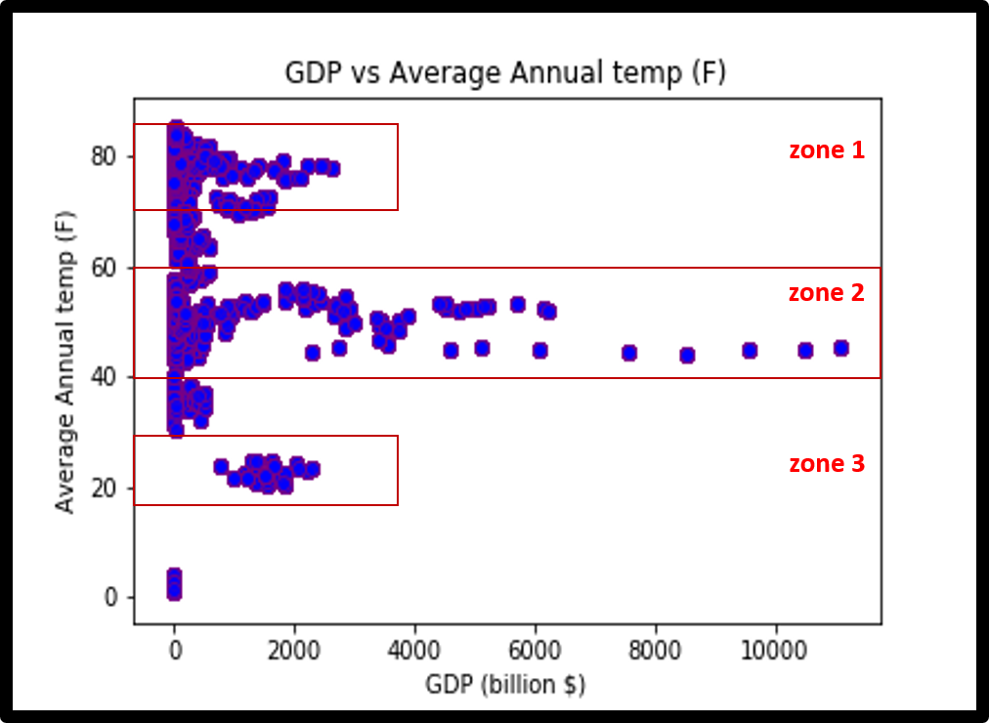
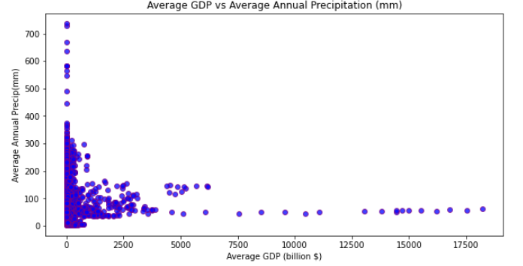
Annual Average Temperature & Precipitation vs GDP
Identified Zones of interest based on the wide range of GDP values for a range of temperatures
zone of interest

Slide 7
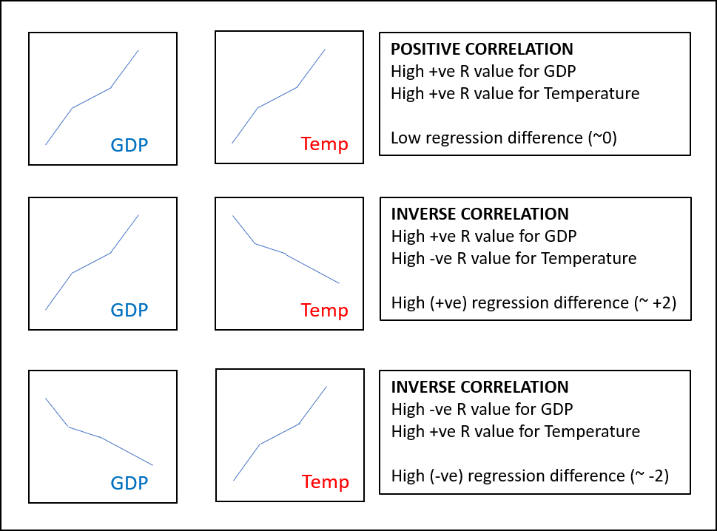
Regression Correlation Technique
Strong positive regression correlation = Low regression difference
Strong inverse regression correlation = High regression difference

Slide 8
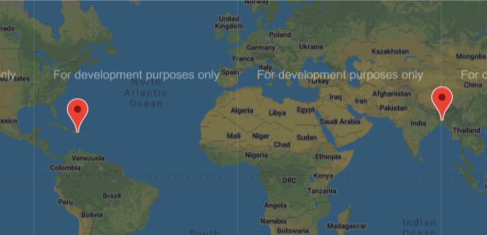
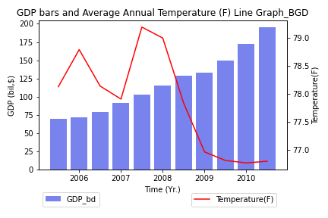
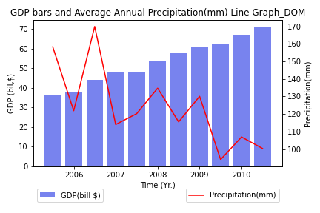
Inversely Correlated Relationship
Country Name: Bangledesh
Temperature r-value: -0.70
GDP r-value: 0.98
Country Name: Dominican Republic
Precipitation r-value: -0.71
GDP r-value: 0.99

Slide 9
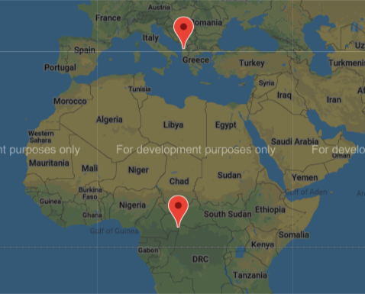
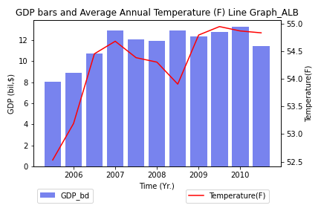
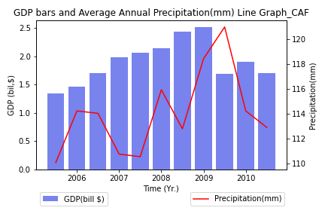
Positively Correlated Relationship
Country Name: Albania
Temperature r-value: 0.76
GDP r-value: 0.71
Country Name: Central African Republic
Precipitation r-value: -0.47
GDP r-value: 0.40

Slide 10
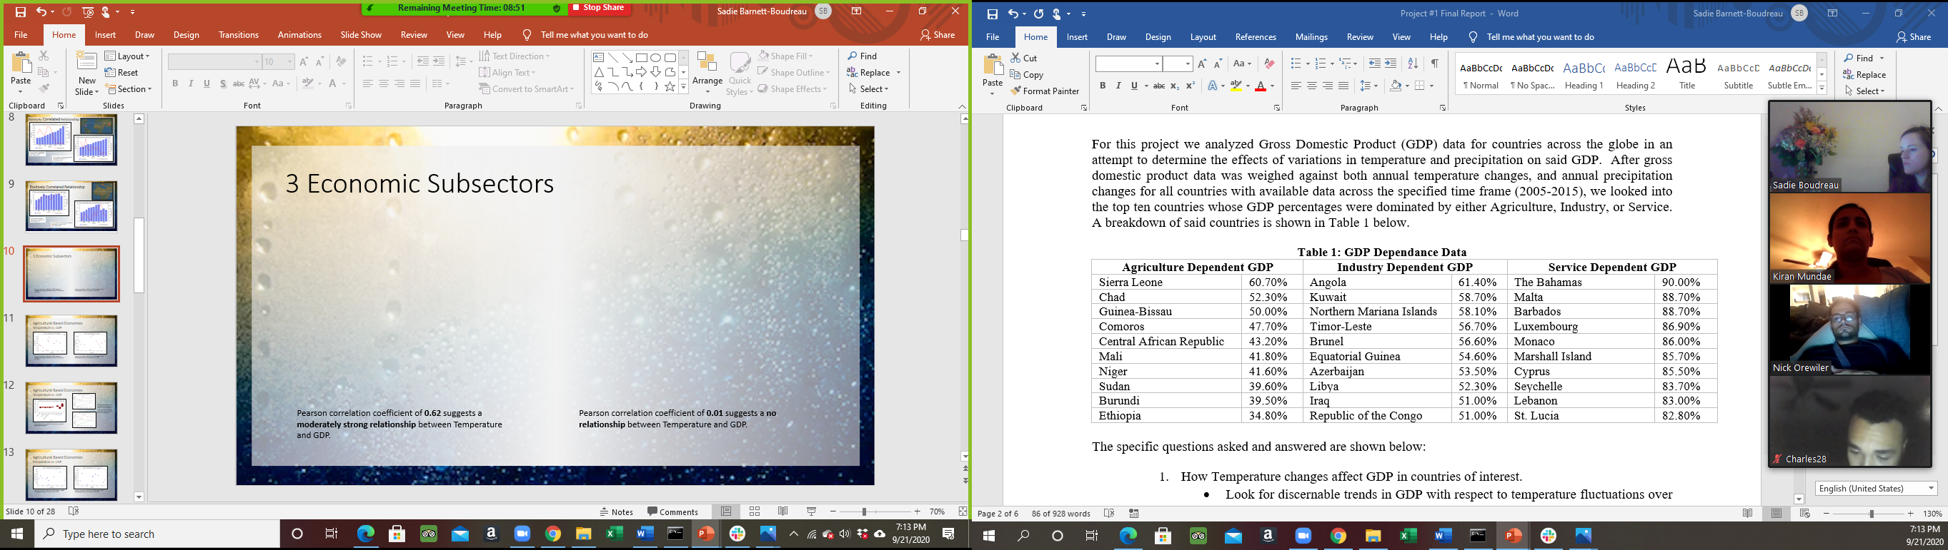
3 Economic Subsectors

Slide 11
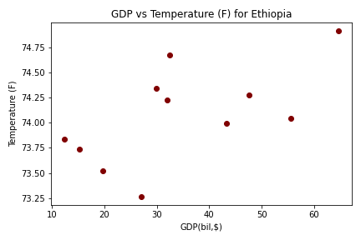
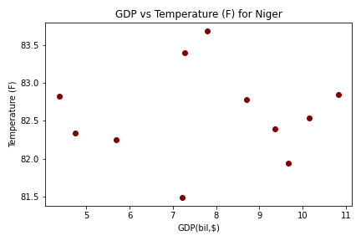
Agricultural Based Economies Temperature vs. GDP
Pearson correlation coefficient of 0.62 suggests a moderately strong relationship between Temperature and GDP.
Pearson correlation coefficient of 0.01 suggests a no relationship between Temperature and GDP.

Slide 12
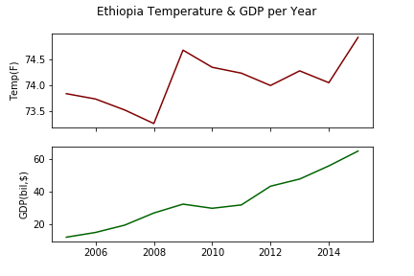
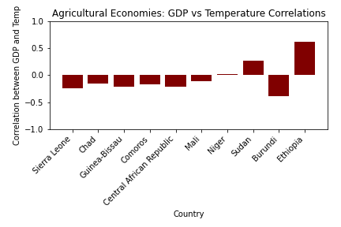
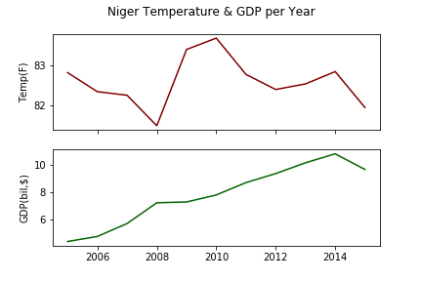
Agricultural Based Economies Temperature vs. GDP
When compared over time, Temperature and GDP do not tend to track well even in countries that showed a moderately high correlation over a ten year period.
Relationships across Agricultural Countries are mostly weak and inconsistent.

Slide 13
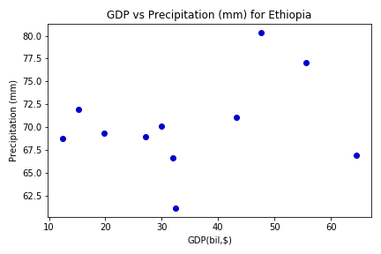
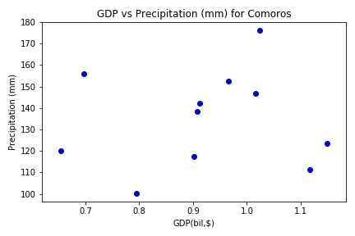
Agricultural Based Economies Precipitation vs. GDP
Pearson correlation coefficient of 0.28 suggests a weak relationship between Precipitation and GDP.
Pearson correlation coefficient of 0.08 suggests a no relationship between Precipitation and GDP.

Slide 14
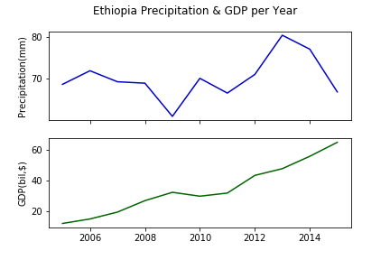
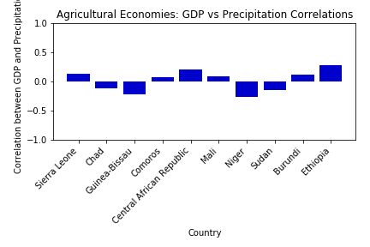
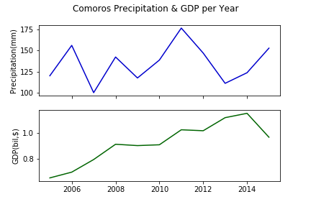
Agricultural Based Economies Precipitation vs. GDP
When compared over time, Precipitation and GDP do not tend to track well even in countries that showed a moderately high correlation over a ten year period.
Relationships across Agricultural Countries are all weak and inconsistent.

Slide 15
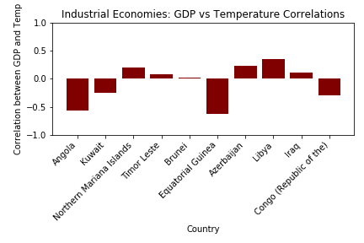
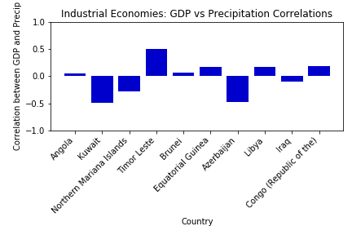
Industrial Based Economies Weather vs. GDP
The correlation between Weather and GDP was inconsistent and show no relationship between the two

Slide 16
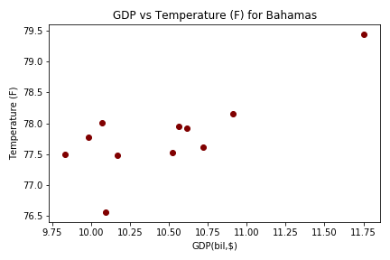
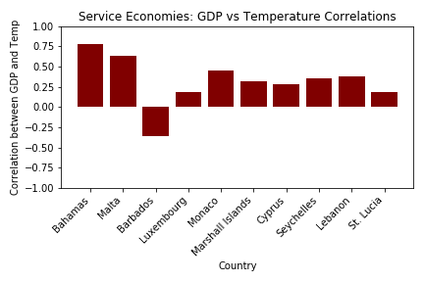
Service Based Economies Temperature vs. GDP
Pearson correlation coefficient of 0.78 suggests a relatively strong relationship between Temperature and GDP.
There does seem to be some consistency in correlations between Temperature and GDP in service dominated economies

Slide 17
Conclusions
Can ∆’s in GDP be seen w/ respect to ∆’s in weather globally?
No
Can ∆’s in GDP be seen w/ respect to ∆’s in weather for Agriculturally dominated countries?
No
Can ∆’s in GDP be seen w/ respect to ∆’s in weather for Industry dominated countries?
No
Can ∆’s in GDP be seen w/ respect to ∆’s in weather for Service dominated countries?
Possible relationship between Temperature and GDP
No relationship between Precipitation and GDP

Slide 18
Conclusions
Too many outside variables effecting GDP
Looking at data on an annual basis rather than quarterly (or during growing season) showed no noticeable effect
Only when drilling down into specific GDP sector compositions could some correlation be seen, but even then, it was minimal.
Some correlation could be seen in Service based economies between temperature and GDP, possibly because said countries are dependent on tourism and good weather brings tourism which increases GPD
This was a lot for work for little to no results

Slide 19

Limitations
World Bank GDP data was not available for all countries.
There were gaps within the frame of reference (2005-2015)
Analyzing quarterly GDP data
Outside factors/variables effecting the overall GDP data
Further analysis into extreme weather conditions or other possible weather phenomenon for variations in GDP

Slide 20

What could we have done better?
Analyzing quarterly GDP & weather data
Only looked at the growing season for Agriculturally based economies
Looked at specific regions with stable economies for more focused study
Filtered out countries experiencing Civil/Economic unrest
Filtered out sanctioned countries, or economies dependent on black market goods

Slide 21
Any Questions?

